Slide 1
Student Social Media Addiction Analysis
An Excel Dashboard Insight by Ruth Yakubu

Slide 2
Overview of the Analysis
Dataset: Survey of 705 students on social media usage
Goal: Understand how social media impacts academic performance and relationships
Tool Used: Microsoft Excel (Pivot Tables, Slicers, Charts, Dashboard)

Slide 3
Filters and Key Dimensions Used
Gender (Female, Male)
Most Used Social Media Platform
Daily Usage Hours
Affects Academic Performance (Yes/No)
Relationship Status

Slide 4
Average Daily Social Media Usage
Female: 1768.9 mins/day
Male: 1698.8 mins/day
Female use social media slightly more on average

Slide 5
Most Used Platforms and Usage Hours
TikTok and Instagram dominate usage
LINE and KakaoTalk had relatively lower average daily usage
Platform preference correlates with addiction level

Slide 6
Usage vs. Academic Performance
Students who reported negative academic performance:
Usage > 2500 mins/day on average
Suggests heavy social media usage may impact academic outcomes

Slide 7
Platforms Associated With Poor Academic Performance
TikTok, Instagram, and Twitter users showed higher negative performance
Need for awareness on healthy platform usage

Slide 8
Addiction Score by Platform
Average addiction scores were highest for TikTok and Instagram
WhatsApp and Facebook showed lower scores
Addiction correlated with time spent per day

Slide 9
Impact on Relationships
Conflict due to social media reported across all relationship types
Most affected group: Students in relationships
Platforms triggering conflict: Instagram, Snapchat, TikTok

Slide 10
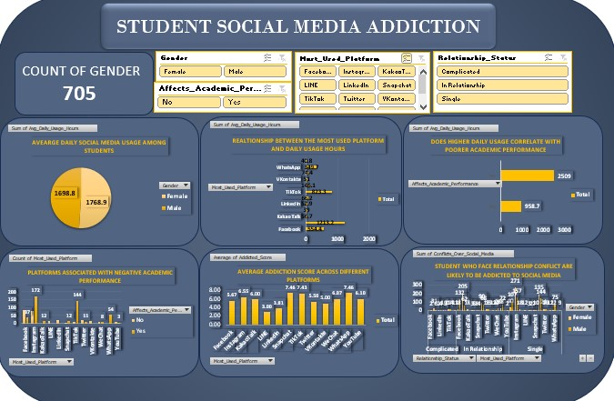

Slide 11
Summary and Recommendations
Social media addiction is more than screen time—platform habits matter
High usage correlates with poorer performance and relationship conflicts
Encourage healthy media habits and digital wellness education in schools

